Slide 1
SMART HOME AUTOMATION AND SURVEILLANCE SYSTEM
P.SWAMINATHA – EC23B1091
Y.V. SASIDHAR – EC23B1095
L. SAI RAM – EC23B1106

Slide 2
Features:
This system consists of 3 sub-divisions
  Home surveillance using the ESP Cam module to detect intruder if motion is detected.
  Capturing soil moisture to trigger the motor for watering the plants.
  Capturing the speech using the microphone and using an API to convert into text for controlling home appliances.

Slide 3
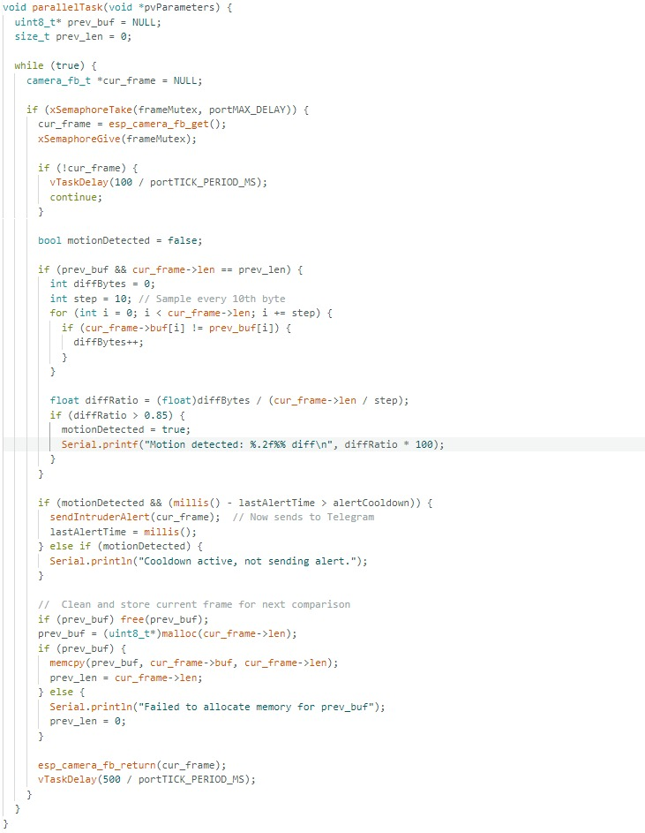
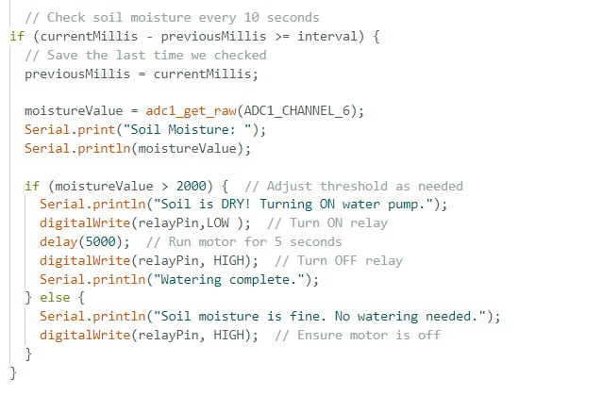
CODE SNIPPETS:

Slide 4
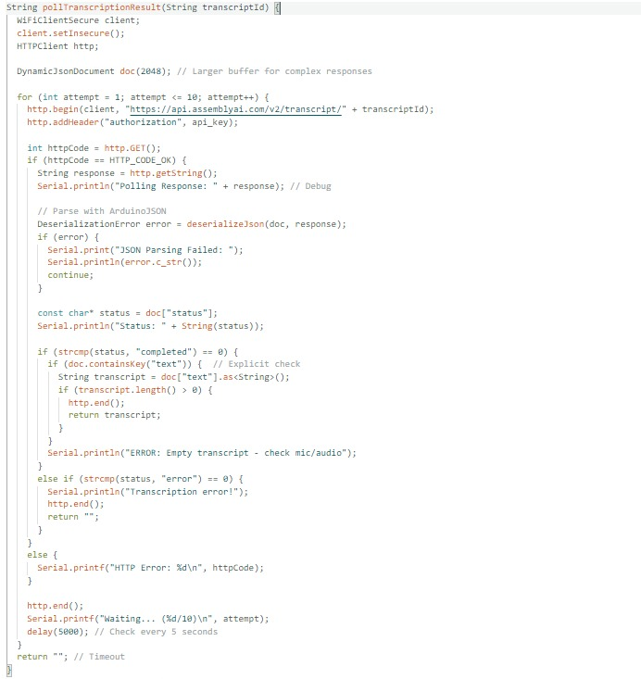
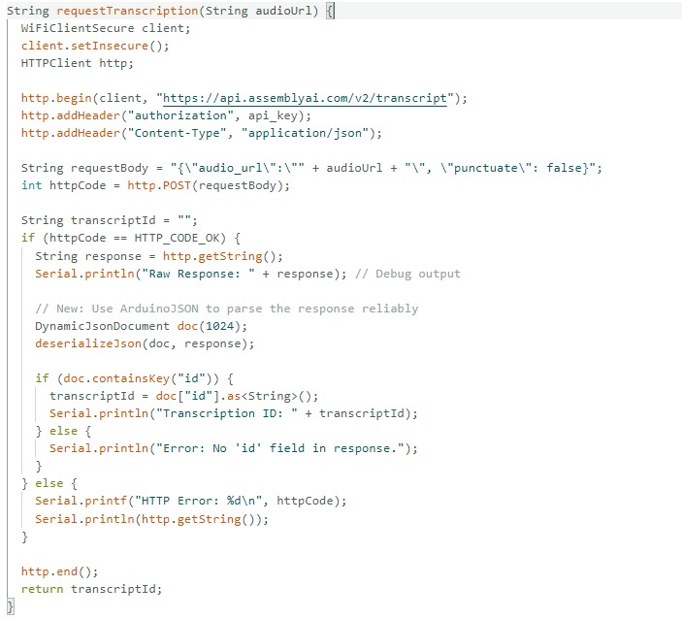
CODE SNIPPETS:

Slide 5
HARDWARE COMPONENTS REQUIRED
ESP Wroom 32
ESP 32 CAM
Capacitive Soil Moisture sensor
Microphone (INMP441)
Led
6V DC motor
Relay module
9V battery

Slide 6
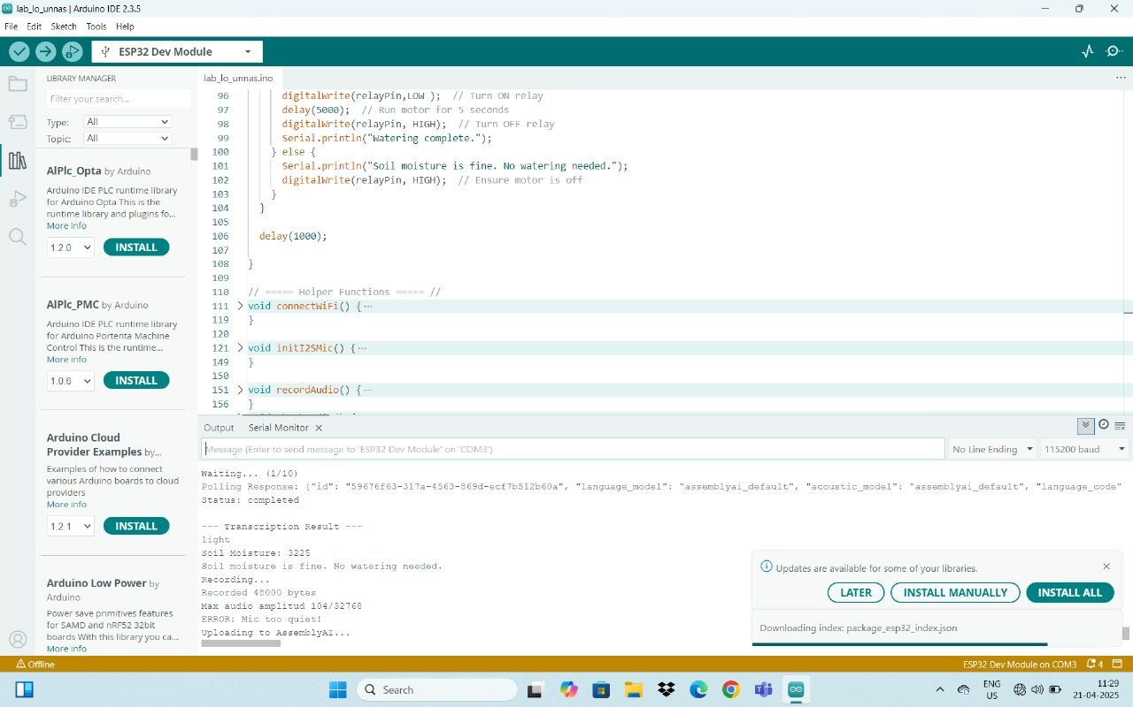
RESULTS

Slide 7
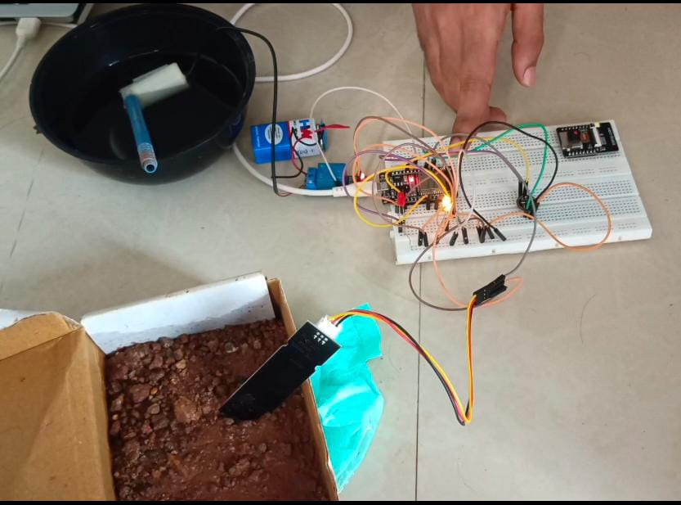
RESULTS

Slide 8
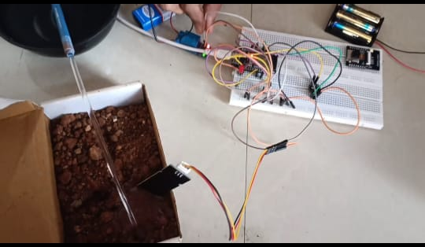
RESULTS

Slide 9


RESULTS

